Slide 1
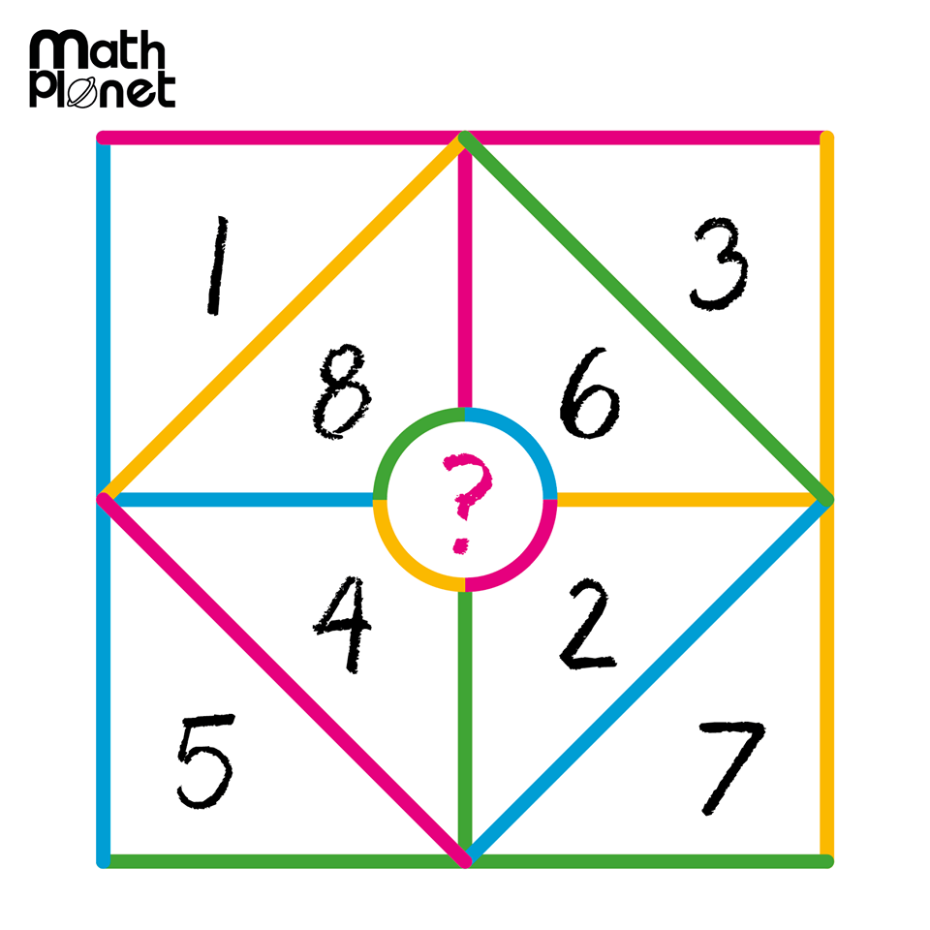
24
7
30
Date
Multiplying and Dividing Integers
EQ – How do you multiply and divide negative numbers?

Slide 2
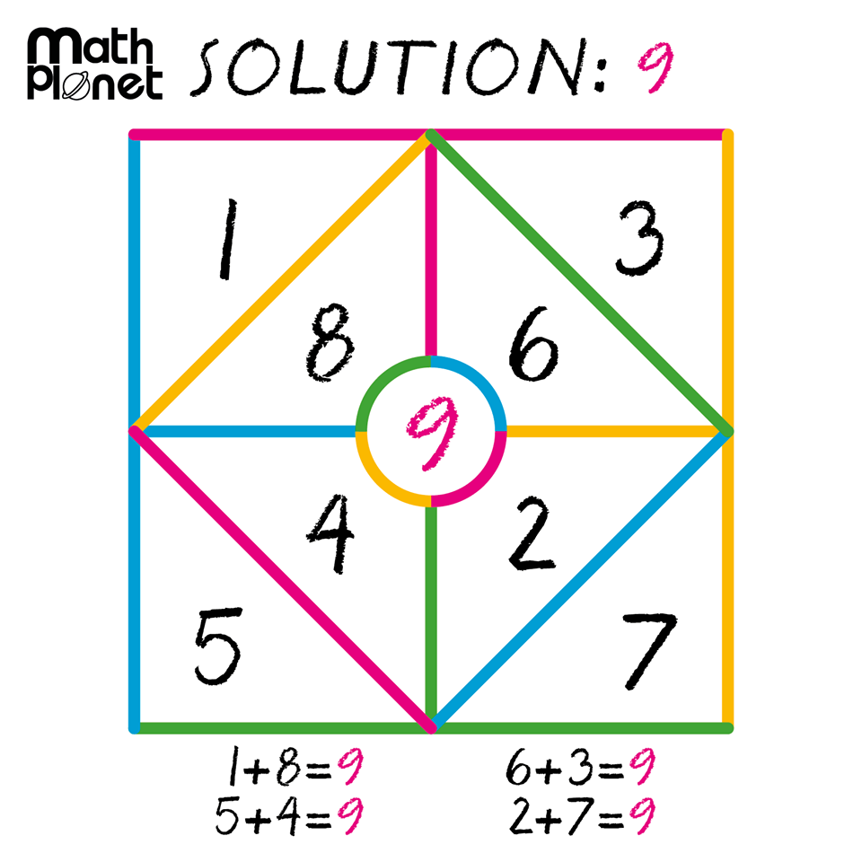

Slide 3
Task One (review from last lesson)
Don’t just write the answer, write the question as well to help you when reviewing.
2 + 3 =
2+(-3) =
2 – 3 =
2 – (-3) =

Slide 4
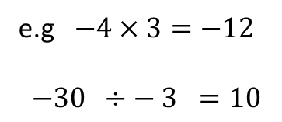
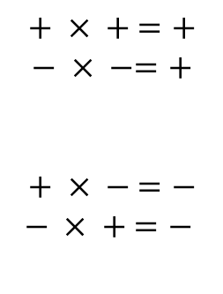
24
7
30
Date
Multiplying and Dividing Integers
EQ – How do you multiply and divide negative numbers?
What are the rules for multiplying and dividing?
If both numbers are the same sign then the answer is positive
$$+ × + =+$$
$$− × −=+$$
$$+ × − =−$$
$$− × + =−$$
Same sign +
If both numbers are different signs then the answer is negative
different signs –
e.g $−4×3=−12$
$−30 ÷− 3 =10$

Slide 5

Task-two
$2×3=$
$2×−3=$
$−2×3=$
$−2×−3=$

Slide 6
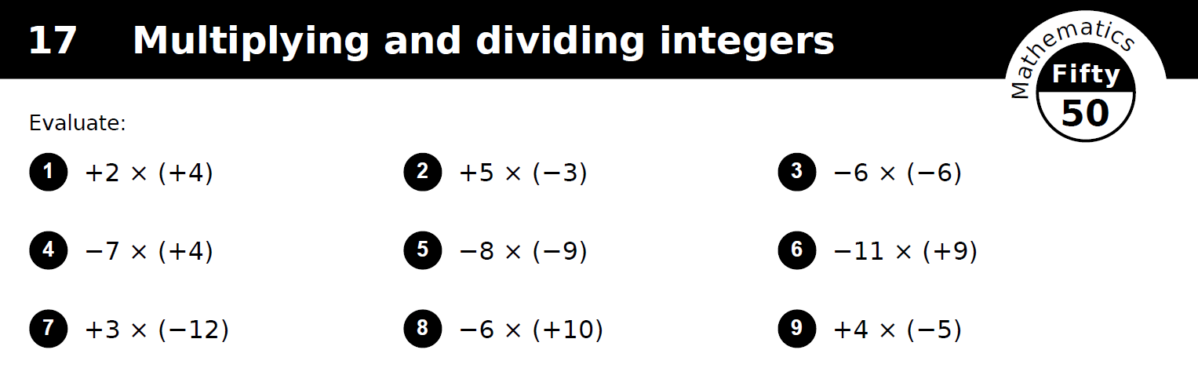
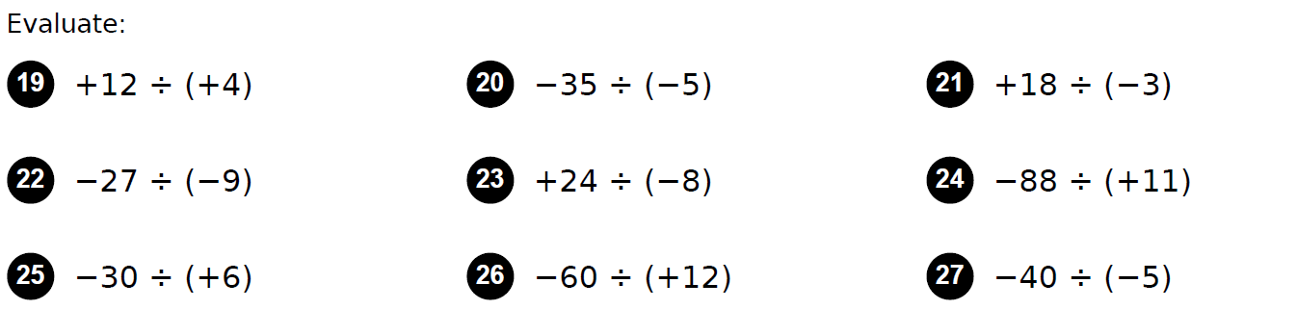
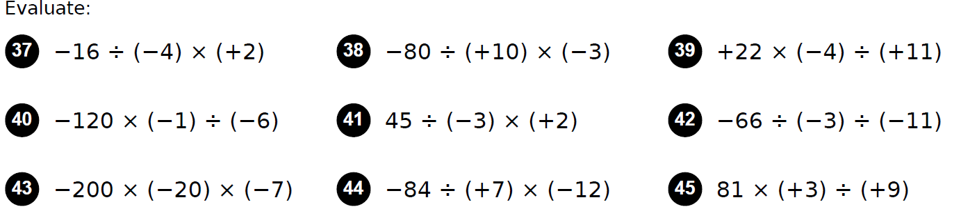
Task 3
Minimum: pick 3 from each
Medium: pick 5 from each
Advanced: ALL!!

Slide 7
Questions

